Slide 1
Varying-Coefficient Model for Interpreting Monthly Hospitalization Rates of COVID-19
Benjamin Garcia
April 23rd, 2025
University of Central Florida

Slide 2
Overview
Introduction
COVID-19 Overview
Tripledemic
Data Preprocessing
Varying Coefficient Model
Results
Conclusion
Limitations/Future Research
References

Slide 3
Introduction
Since March 2020, COVID-19 has been monitored due to its global significance and impact.
Countless methods have been used to retroactively fit and predict COVID-19 rates (cases, deaths, hospitalization, etc.)
Varying-coefficient models, flexible and interpretable in nature, should be considered.
This project aims to model the monthly rate of COVID-19 hospitalizations using a varying-coefficient model and compare its fit to other methods.

Slide 4
COVID-19 Overview
COVID-19 was a global pandemic that garnered global attention in the beginning of the 2020s.
Even though COVID-19 is no longer considered a pandemic, the CDC continues to track COVID-19 data from COVID-NET surveillance.
COVID-NET COVID-19 hospitalization rates from March 2020 – February 2025 (60 months) were used for the analysis.

Slide 5
Tripledemic
In the early stages of the COVID-19 pandemic, flu rates and Respiratory syncytial virus (RSV) rates were extremely low due to current health protocols (den Hartog et al, 2023).
In the winter of 2022, a phenomenon called the ‘Tripledemic’ occurred (Bi et al., 2025).
This meant the rates of COVID-19, Respiratory syncytial virus (RSV), and the flu all increased at similar times.
This put an undue strain on local, national, and global resources.
Being able to model these communicable diseases and understand their relationship could help in future combat against them.

Slide 6
Tripledemic
The CDC monitors these diseases using COVID-NET, FluSurv-NET, and RSV-NET which are all apart of Respiratory Virus Hospitalization Surveillance Network (RESP-NET) (CDC.org).
These surveillance platforms cover more than 30 million people and include an estimated 10% of the U.S. population (CDC.org).
The hospitalization rates are defined as the total number of events divided by the population at risk (per 100,000).

Slide 7
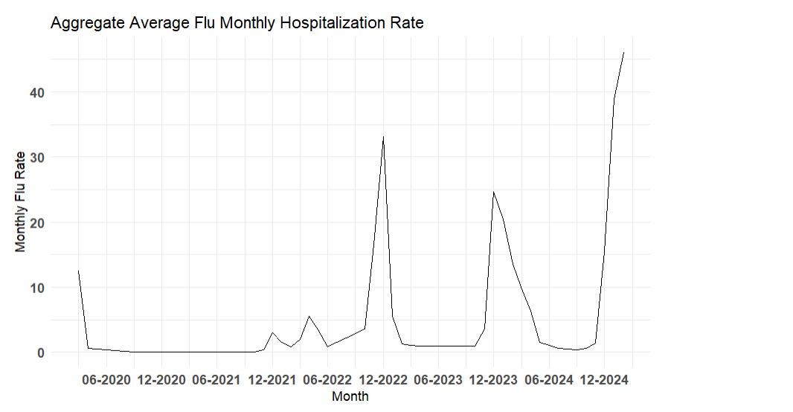
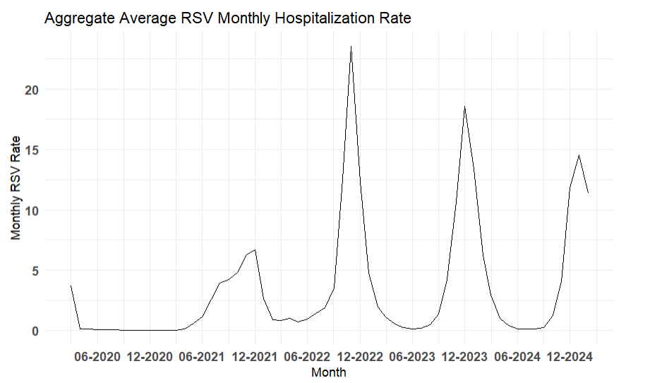
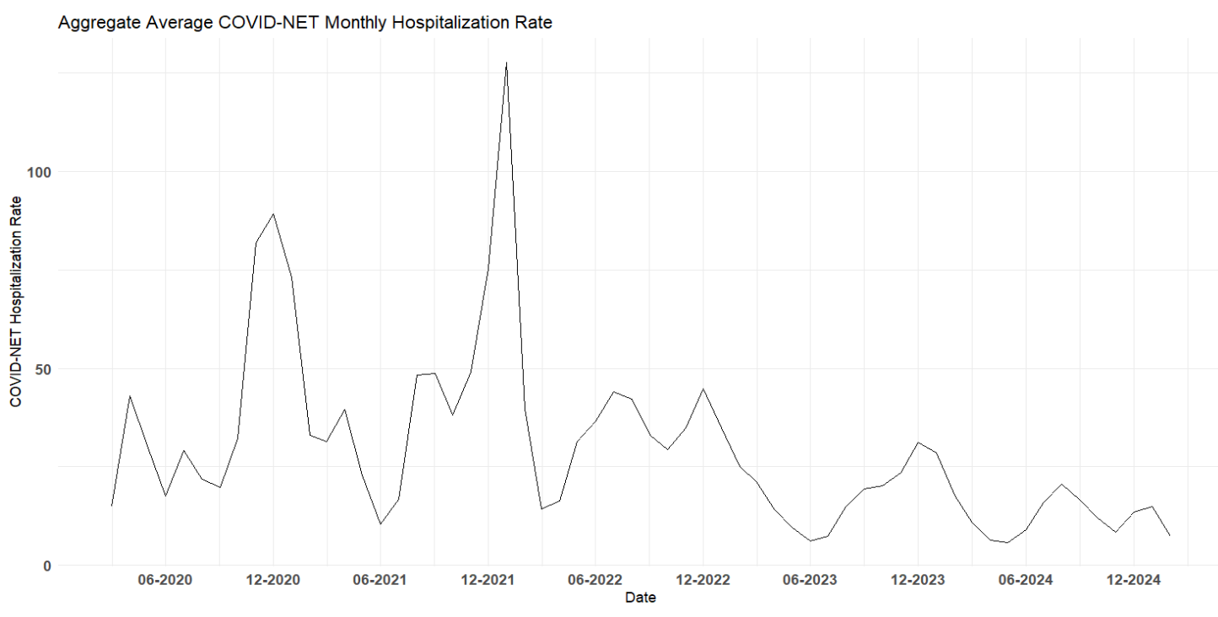
Tripledemic

Slide 8
Data Preprocessing
The original data sets for COVID-19, the flu, and RSV hospitalization rates were reported distinctly for state, gender, race, and age.
The data was aggregated over these variables so that an overall average for each month could be used for analysis.
The flu data had to be adjusted from weekly to monthly.

Slide 9
Data Preprocessing
While the CDC maintains surveillance and hosts a large amount of communicable disease data, there are gaps present in the data.
This is due to the non-collection of flu and RSV hospitalization rates during their offseason.
The function na_seadec() in the imputeTS package (Cleveland et.al, 1990) was used to impute the data that was not reported.

Slide 10

Varying Coefficient Model
Varying Coefficient Model or VCM is a model of the form y = X^{T} a(U)+ ε (Fan & Zhang, 2008).
The estimator of the coefficients is the a in the following minimizer function.
L(a,b) = $\sum_{i=1}^{n}{{{\{y}_{i}− {X^{T}}_{i}a−{X^{T}}_{i}b(U_{i}−u)\}}^{2}} K_{h}(U_{i}−U)$ (Fan & Zhang, 2008).

Slide 11

Varying Coefficient Model
To find the coefficients we must then use
$\hat{a}\left(u\right)=(I_{p},0_{p}){({Γ^{T}}_{u}W_{u}Γ_{u})}^{−1}{Γ^{T}}_{u}W_{u}Y$ (Fan & Zhang, 2008)
Where $X={(X_{1}, …,X_{n})}^{T}$,
$U_{u}=diag\left(U_{1}−u, …,U_{n}−u\right), { Γ}_{u}$ = (X,$U_{u}$,X)
$W_{u}$ = $diag\left(K_{h}\left(U_{1}−u\right), …,K_{h}(U_{n}−u)\right)$
Y$={(y_{1}, …,y_{n})}^{T}$

Slide 12
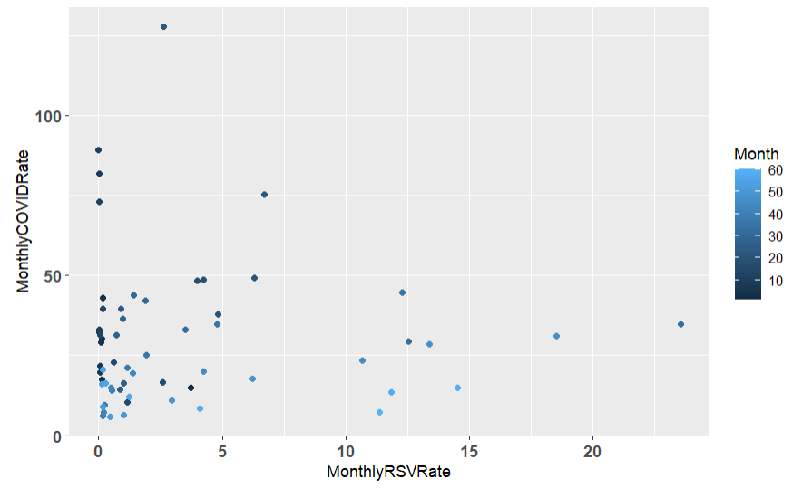
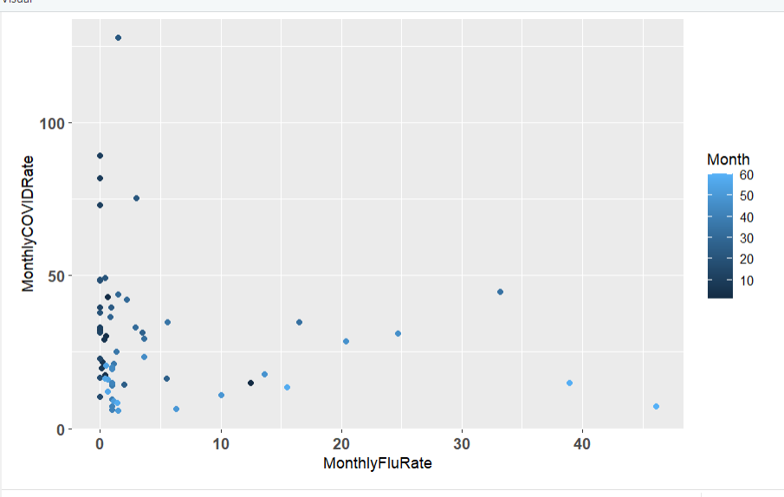
Varying Coefficient Model

Slide 13
Varying Coefficient Model
Now we can set monthly COVID-19 hospitalization rates as the target.
Month from 1 to 60 was the variable that the coefficients were dependent on.
Monthly RSV and flu hospitalization rates will be our predictors along with annual and semiannual seasonal effects.
s1 = cos(2 * pi * Month / 12)
s2 = sin(2 * pi * Month / 12)
s3 = cos(2 * pi * Month / 6)
s4 = sin(2 * pi * Month / 6)

Slide 14
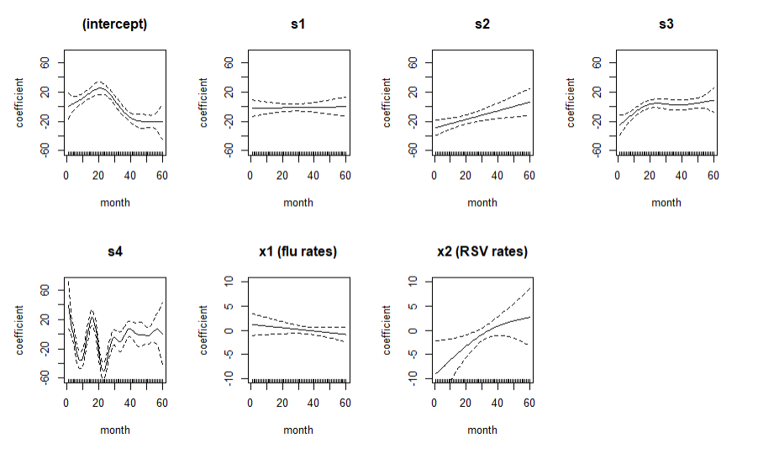
Varying Coefficient Model

Slide 15
Results
R’s linear model function (Chambers, 1992)
Random forest from the randomforest package (Breiman, 2001)
A time-varying linear model from the tvreg package (Casas and Fernandez-Casal, 2022)
Varying coefficient model in the mgcv package (Wood, 2017)
To find the best model, parameter tuning including leave-one-out cross-validation (LOOCV) using multiple bandwidth values was tested.

Slide 16
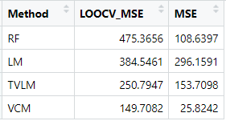
Results
LOOCV was used to compute the mean squared error (MSE).
Then the MSE was calculated on all the data.

Slide 17
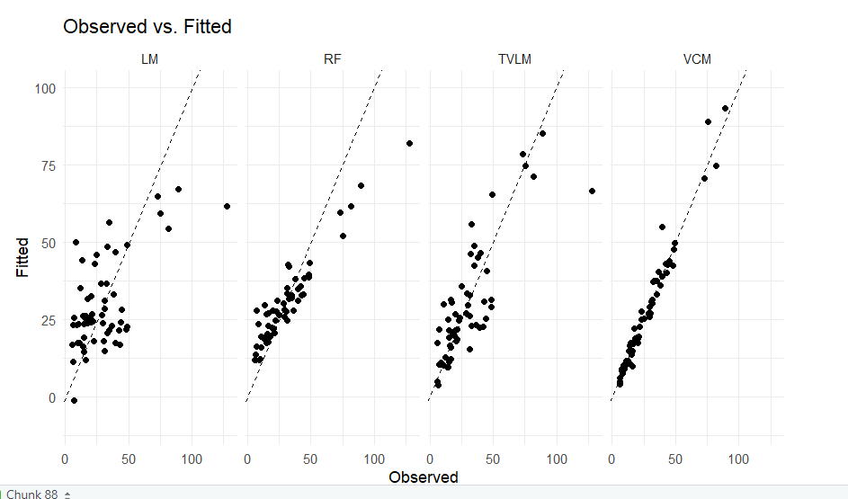
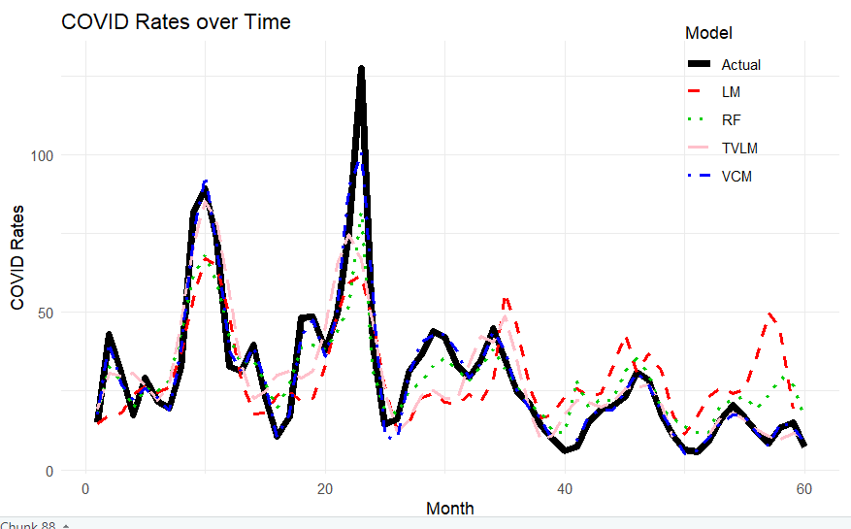
Results
Around month 35 is when the Tripledemic occurred.

Slide 18
Conclusion
With parameter tuning, the VCM seems to fit the COVID-19 monthly hospitalization rate the best.
Random forest predicts COVID-19 monthly hospitalization rate well when using the data it was trained on but suffers more drastically when new data is introduced.
The seasonality and rates of RSV and the flu hospitalization can inform us about COVID-19 hospitalization within the corresponding surveillance network.

Slide 19
Limitations / Future Research
The surveillance network used only accounts for a part of the U.S. and may not correspond to rates of the nation as a whole.
The imputed values could vary from the actual values.
Future work on the differences between certain demographic statuses along with further variable selection, could be explored.

Slide 20
References
Breiman, L. (2001), Random Forests, Machine Learning 45(1), 5-32.
Bi, K., Bandekar, S. R., Bouchnita, A., Fox, S. J., & Meyers, L. A. (2025). Annual hospitalizations for covid-19, influenza, and respiratory syncytial virus, United States, 2023–2024. Emerging Infectious Diseases, 31(3), 636–638. https://doi.org/10.3201/eid3103.240594
Casas, I., & Fernández-Casal, R. (2022). TvReg: Time-varying coefficients in multi-equation regression in R. The R Journal, 14(1), 79–100. https://doi.org/10.32614/rj-2022-002
Centers for Disease Control and Prevention. (n.d.). Covid-Net. Centers for Disease Control and Prevention. https://www.cdc.gov/covid/php/covid-net/index.html
Chambers, J. M. (1992) Linear models. Chapter 4 of Statistical Models in S eds J. M. Chambers and T. J. Hastie, Wadsworth & Brooks/Cole.
Cleveland, R. B., Cleveland, W. S., McRae, J. E., & Terpenning, I. (1990). STL: A seasonal-trend decomposition. J. off. Stat, 6(1), 3-73.
den Hartog, G., van Kasteren, P. B., Schepp, R. M., Teirlinck, A. C., van der Klis, F. R., & van Binnendijk, R. S. (2023). Decline of RSV-specific antibodies during the COVID-19 pandemic. The Lancet Infectious Diseases, 23(1), 23–25. https://doi.org/10.1016/s1473-3099(22)00763-0
Fan, J., & Zhang, W. (2008). Statistical methods with varying coefficient models. Statistics and Its Interface, 1(1), 179–195. https://doi.org/10.4310/sii.2008.v1.n1.a15
Hastie, T. J., Tibshirani, R., & Friedman, J. (2009). Kernel Smoothing Methods. In The Elements of Statistical Learning Data Mining, Inference, and Prediction (2nd ed., pp. 191–218). essay, Springer.
Hastie, T., & Tibshirani, R. (1993). Varying-coefficient models. Journal of the Royal Statistical Society Series B: Statistical Methodology, 55(4), 757–779. https://doi.org/10.1111/j.2517-6161.1993.tb01939.x
Liu, J., Bellows, B., Hu, X. J., Wu, J., Zhou, Z., Soteros, C., & Wang, L. (2023). A new time-varying coefficient regression approach for analyzing infectious disease data. Scientific Reports, 13(1). https://doi.org/10.1038/s41598-023-41551-1
Luo, W., Liu, Q., Zhou, Y., Ran, Y., Liu, Z., Hou, W., Pei, S., & Lai, S. (2023). Spatiotemporal variations of “triple-demic” outbreaks of respiratory infections in the United States in the post-covid-19 era. BMC Public Health, 23(1). https://doi.org/10.1186/s12889-023-17406-9
Park, B. U., Mammen, E., Lee, Y. K., & Lee, E. R. (2013). Varying coefficient regression models: A review and New Developments. International Statistical Review, 83(1), 36–64. https://doi.org/10.1111/insr.12029
Wood, S. N. (2017). GAMs in Practice: mgcv. In Generalized Additive Models An Introduction with R (2nd ed., pp. 325–397). essay, CRC Press.

